Slide 1
Giving Data to the Field Epis with a Datamart CSTE 2025
Nathan Williams | Epidemiologist 2

Slide 2
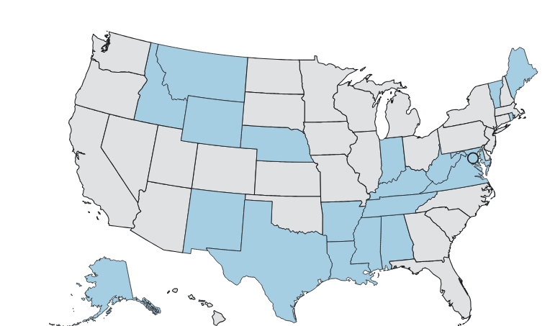
Background
Tennessee is one of 20 states using NBS
NBS does not come with a prebuilt datamart
The data is spread out over multiple databases and tables
Our field epidemiologists did not have access to all the data necessary for their work
These factors led to time-consuming and complex manual processes
This reduced the timeliness of data access and public health action

Slide 3

Methods – Identifying Needs
Understand the layout of the NBS databases
Identifying required values
Meetings with program areas
Determined which values would be needed for field epis

Slide 4

Methods – Field Selection
Identified where those values were in the NBS database
Existing fields
XPATHS for placement into mapping table

Slide 5

Methods – Implementing a Solution
We placed XML values in Mapping table
Places new values in a catch all table
We created a stored procedure that updates daily and places the values needed in a table available to the field epis

Slide 6

Results
We have functioning DataMart for eCR that is available to field epis.
47 fields
used by epis for analysis
used by eCR team for determining data completeness and quality during onboarding

Slide 7
Conclusion
The datamart is an invaluable tool used by many teams
Multiple teams leverage the data found in the datamart
Continues to expand and grow with CDA

Slide 8
Contact information
nathan.w.williams@tn.gov

Slide 9
Thanks
DSTT
Mentor
Anne Zehner
2023 DSTT cohort at TDH
Greg Chambers
Robby Lundergan
Emmie Travers
Hardik Patel
Leah Eisenstein

